Slide 2
Welcome to Database Management Systems
Craig Nelson/CIS 205/003/MW 11:30-2:00

Slide 3
Pointing Students in the Right Direction!
CourseMate is required for this course.
CourseMate includes:
Study tools to help you prepare for tests and exams
Quizzing
eBook
2. Additional study tools, including free study tools, designed to help you study smarter (not harder) are available at CengageBrain.com.

Slide 4
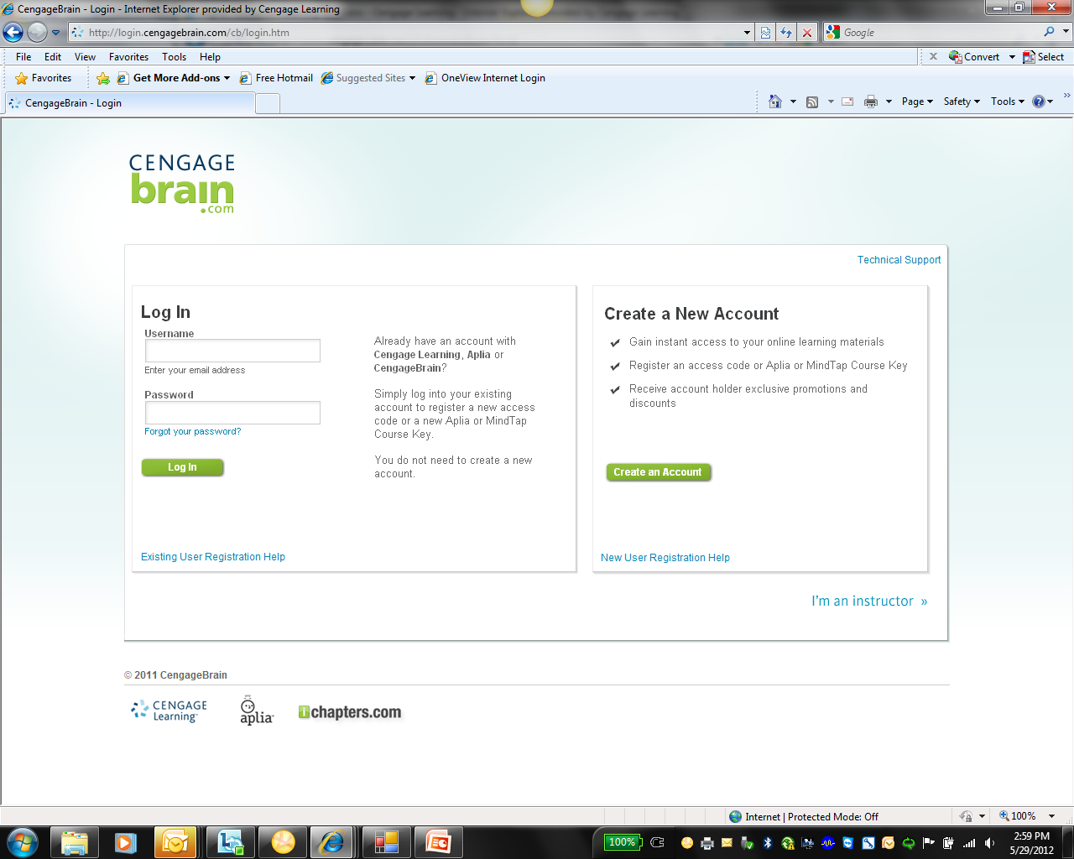
Signing in to CourseMate
Go to login.cengagebrain.com
Click “Create an Account”
(After first time, use “Log In”)

Slide 5
Signing in to CourseMate
Step 1: Enter access code from the Printed Access Card that accompanied your text or Instant Access Code you obtained from CengageBrain.com
Step 2: Fill out account information and click “I agree” to License Agreement

Slide 6
Signing in to CourseMate
Step 3: Enter school information and click “Search”
Step 4: Select school
and click “Continue”

Slide 7
Signing in to CourseMate
Step 5: Click “Open” to access CourseMate

Slide 8
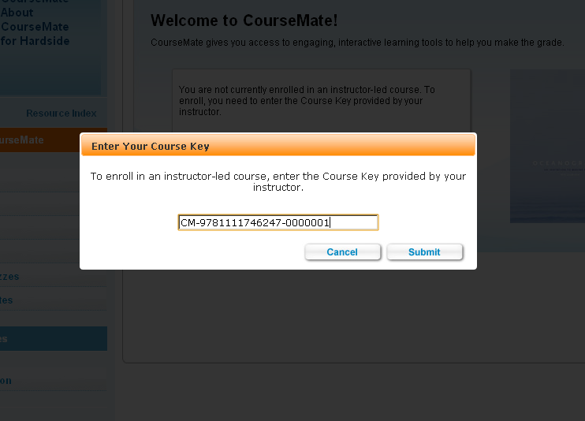
Signing into Your Course
Click “Enter Course Key” and enter
CM-9781133113171-0000056
Notes:
Course Key for Craig’s Sections: CM-9781133113171-0000056

Slide 9
CourseMate
Select Chapter
Select Resource

Slide 10
Thank You
Have a great semester!

